Slide 1

GLOBAL POWER PLATFORM BOOTCAMP
Organized Globally, Held Locally
@GPPBootcampBLR #GPPBootcampBLR #GlobalPowerPlatformBootcamp

Slide 2

Build Powerful reports using DAX functions in Microsoft Power BI
Bijay Kumar Sahoo
Co-Founder TSInfo Technologies – Microsoft MVP
@Fewlines4Biju
@GPPBootcampBLR #GPPBootcampBLR
#GlobalPowerPlatformBootcamp

Slide 3



Sponsors

Slide 4
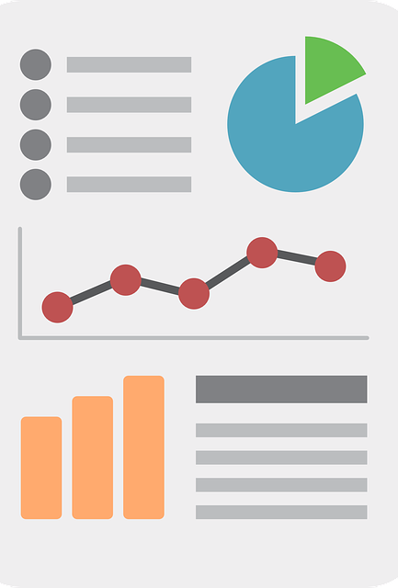
What Will We Discuss?
About Me
What is Power BI
Introduction to Power BI Desktop & Power BI Online
Introduction to Power BI DAX
Power BI DAX Examples
Publish Power BI reports
Any Questions?

Slide 5

I am Bijay
Microsoft MVP (6 Times & Counting)
Co-founder TSInfo Technologies
Running SharePointsky.com & EnjoySharePoint.com
Blogger, Trainer, Consultant & Author Etc.
Driving

Slide 6
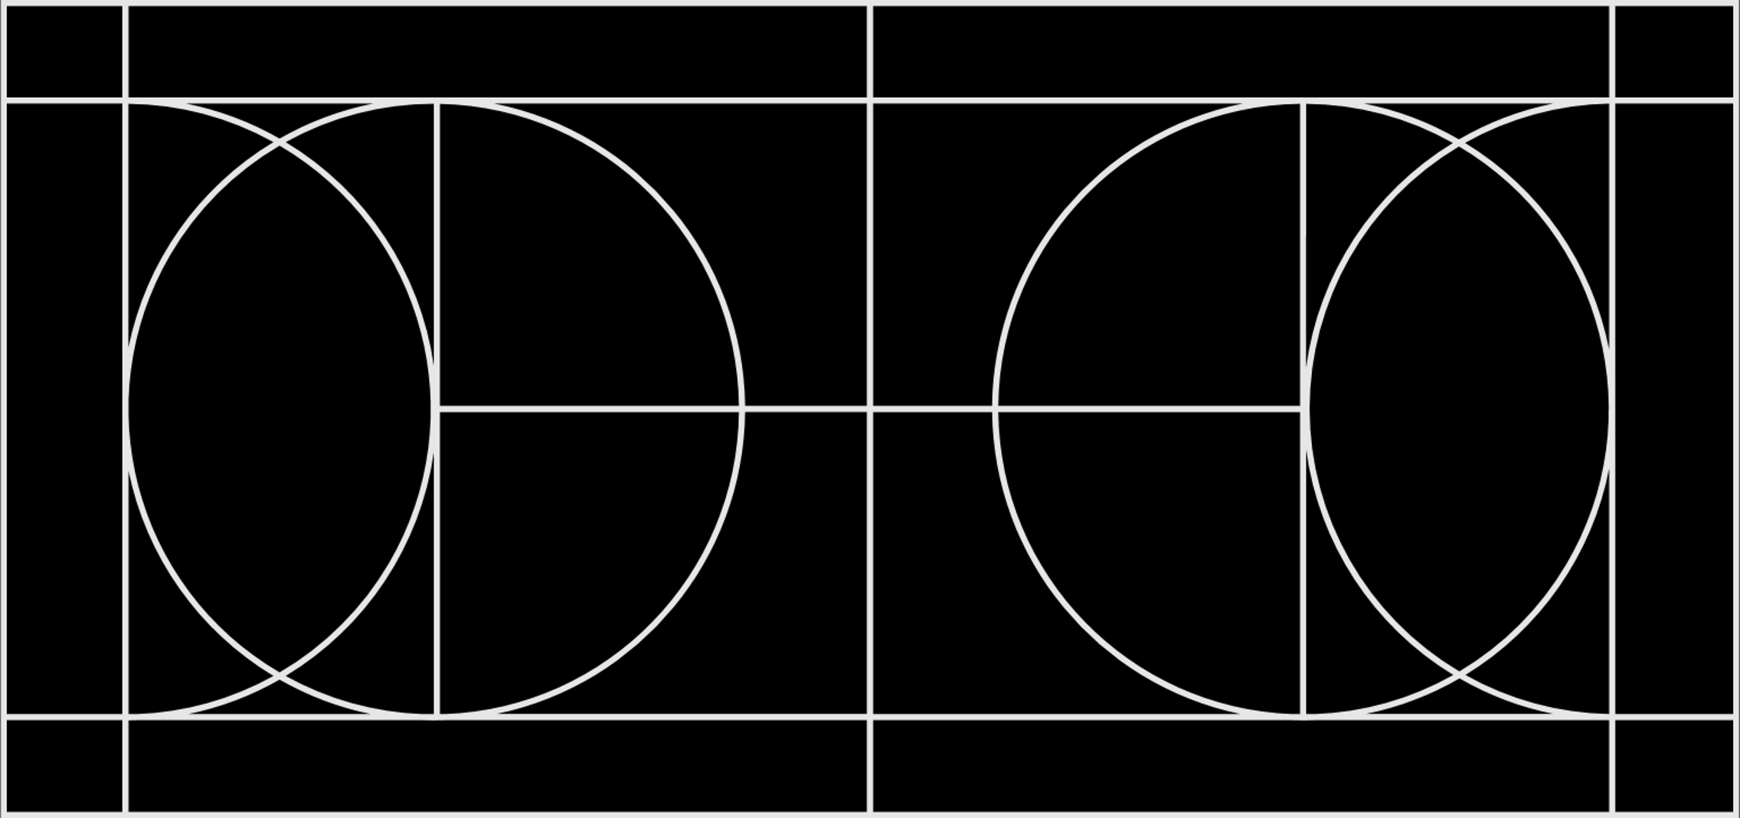
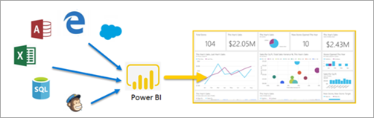
What is Power BI?
Part of Power Platform - business analytics solution
Collection of services, apps, connectors
Connect to Data Source, visualize your with interactive reports, dashboards etc.
Embed to any site and share across organizations

Slide 7
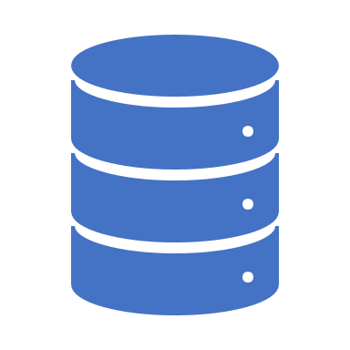
Power BI Desktop & Power BI Service (Online)
Power BI Desktop is a complete data analysis and report creation tool that you install for free application on your local computer.
You can connect to multiple data sources combine them into a data model. On that data model, you can create visuals.
The Power BI service is a cloud-based service. It supports light report editing and collaboration for teams and organizations, modeling is limited.

Slide 8
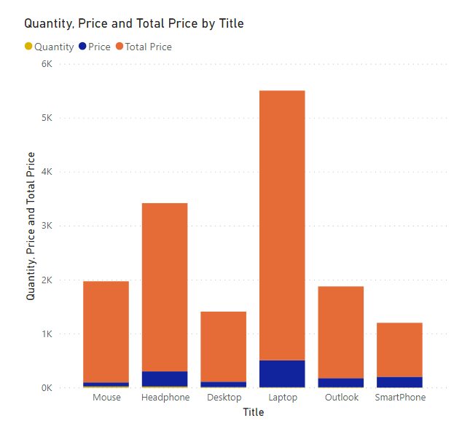
Let’s See a Demo
Connect to a SharePoint data source
Format Data
Create Report
Add New Column
Date Filter

Slide 9

Introduction to Power BI DAX
DAX (Data Analysis Expressions): Is the formula language used throughout Power BI
DAX is a functional language, which means the full executed code is contained inside a function.
DAX functions can contain nested function, conditional statements and value references.
DAX formulas are written in a single line
It has two data types:
Numeric: integers, decimals, and currency
Others: strings and binary objects
Example DISTINCT (column) and DISTINCT (table), Left, Right, & etc.

Slide 10
Types of Calculation we can create using DAX
calculated columns: Use it if you want to slice or filter on the value, or if you want a calculation for every row in your table.
calculated measures: Use a calculated measure when you are calculating percentages or ratios, or you need complex aggregations.

Slide 11

DAX functions
Aggregation functions
Counting functions
Logical functions
Information functions
Text functions
Date functions

Slide 12

DAX functions
SUM
AVERAGE
MIN
MAX
SUMX
COUNT
COUNTA
COUNTBLANK
COUNTROWS
DISTINCTCOUNT
AND
OR
NOT
IF
IFERROR
ISBLANK
ISNUMBER
ISTEXT
ISNONTEXT
ISERROR
CONCATENTATE
REPLACE
SEARCH
UPPER
FIXED
DATE
HOUR
NOW
EOMONTH
WEEKDAY

Slide 13
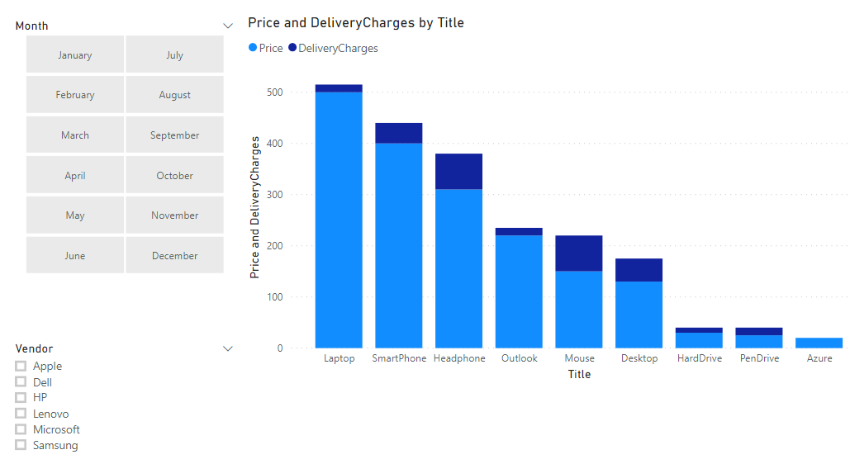
Power BI Reports using DAX

Slide 14

Any Questions?

Slide 15
Power BI Rookie to Pro
Next Session:
Basavaraj Biradar
Software Architect, McAfee

